Slide 1


Data Structure
Dr Shahja
Faculty
School of Engineering & Technology
K.R. Mangalam University
Unit 4 : Sorting and Searching
Dr. Shahjad

Slide 2


SELECTION SORT
Selection sort
Algorithm and Complexity Analysis of Selection sort
Comparative Analysis of Selection Sort with
Insertion Sort
Brainstorming Session

Slide 3
RECAP
Insertion Sort efficiently sorts elements by iteratively inserting each
element into its correct position within a partially sorted array.
It comprises of following steps :
Step 1 : Pick Up
Step 2 : Compare and Place
Step 3: Insert

Slide 4
Selection Sort
It operates by maintaining a partition of the given array into the
following two arrays, at any point:
The subarray which is already sorted.
The remaining subarray, which has yet not been sorted.
In each of its iterations, the selection sort finds the smallest/largest element in the unsorted subarray and moves it to the sorted subarray.
https://visualgo.net/en/sorting?slide=1
[Refer the link for better understanding of Insertion Sort]

Slide 5
Steps Involved In Selection Sort
Step 1: Find the smallest element in the array and swap it with the first element of the array i.e. a[0].
Step 2: The elements left for sorting are n-1 so far. Find the smallest
element in the array from index 1 to n-1 i.e. a[1] to a[n-1] and swap it with a[1].
Step 3: Continue this process for all the elements in the array until
we get a sorted list.

Slide 6



Real World Applications of Insertion Sort
Favourite music app arranges songs
from least to most played
An online store lists products from
cheapest to priciest

Slide 7
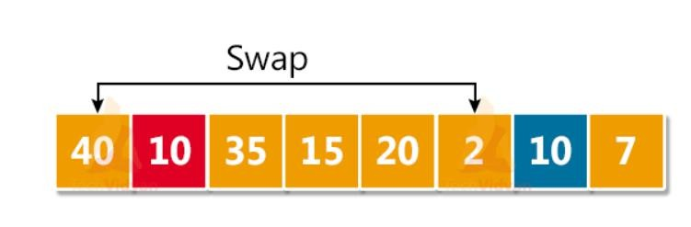
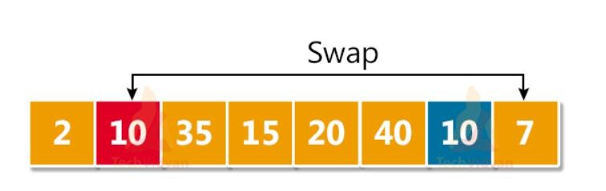
Example of Selection Sort
Let's take an array of 8 elements. int arr [8] = {40, 10, 35, 15, 20, 2, 10, 7 }
ITERATION 1 :
ITERATION 2 :

Slide 8
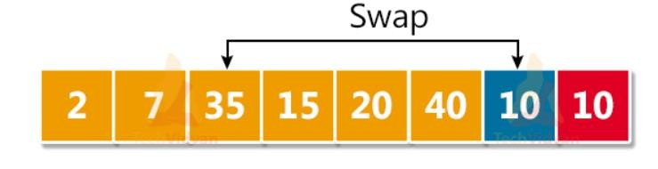
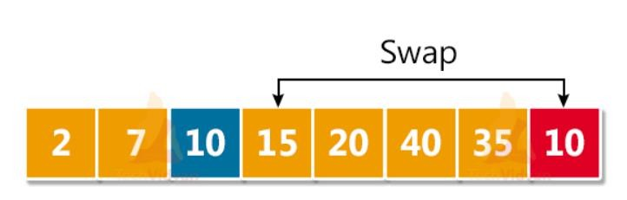
Example of Selection Sort
Let's take an array of 8 elements. int arr [8] = {40, 10, 35, 15, 20, 2, 10, 7 }
ITERATION 3 :
ITERATION 4 :

Slide 9
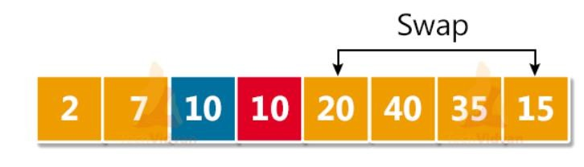
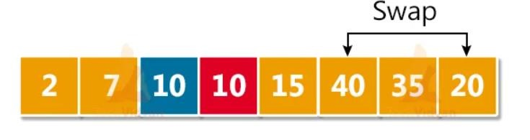
Example of Selection Sort
Let's take an array of 8 elements. int arr [8] = {40, 10, 35, 15, 20, 2, 10, 7 }
ITERATION 5 :
ITERATION 6 :

Slide 10
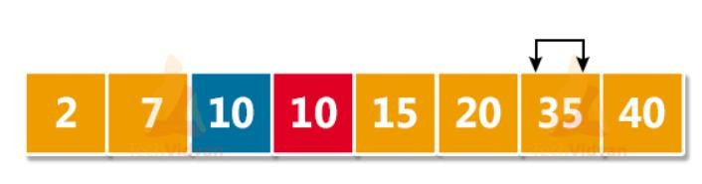
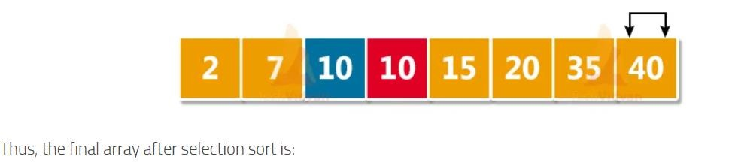
Example of Selection Sort
Let's take an array of 8 elements. int arr [8] = {40, 10, 35, 15, 20, 2, 10, 7 }
ITERATION 7 :
ITERATION 8 :

Slide 11

Exercise : Selection Sort
Sort the following Array using Selection Sort

Slide 12
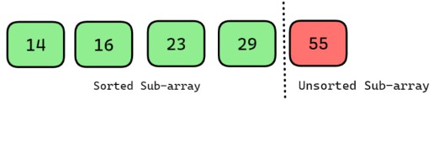
Selection Sort Algorithm
Step 1: For i = 1 to n-1
Step 2: Set min = arr[i]
Step 3: Set position = I
Step 4: For j = i+1 to n-1 repeat: if (min > arr[j])
Set min = arr[j] Set position = j [end of if] [end of loop]
Step 5: swap a[i] with arr[position] [end of loop]
Step 6: END

Slide 13

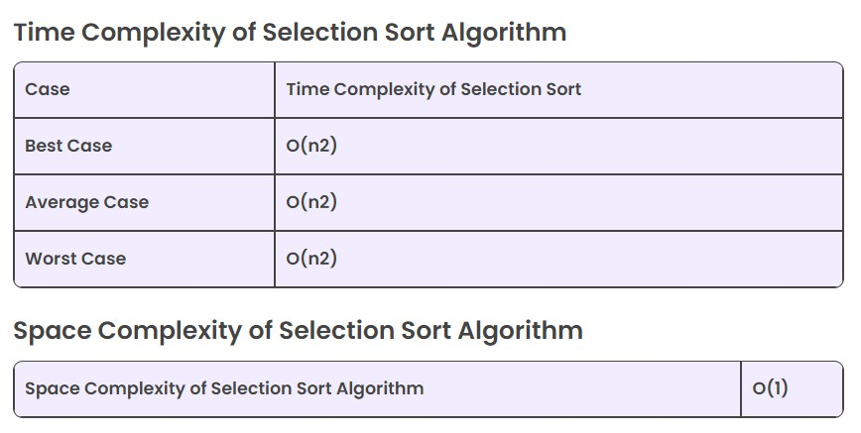
Selection Sort Algorithm Complexity Analysis

Slide 14
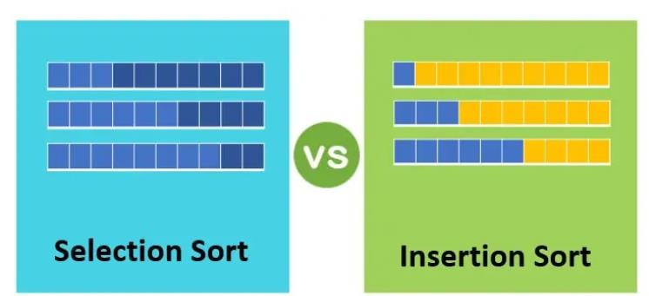
Comparison of Selection and Insertion Sort

Slide 15
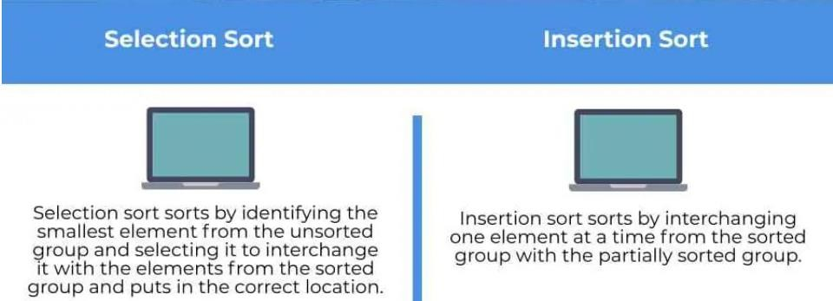
Comparison of Selection and Insertion Sort

Slide 16
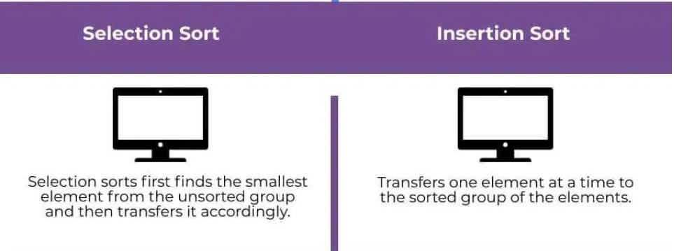
Comparison of Selection and Insertion Sort

Slide 17
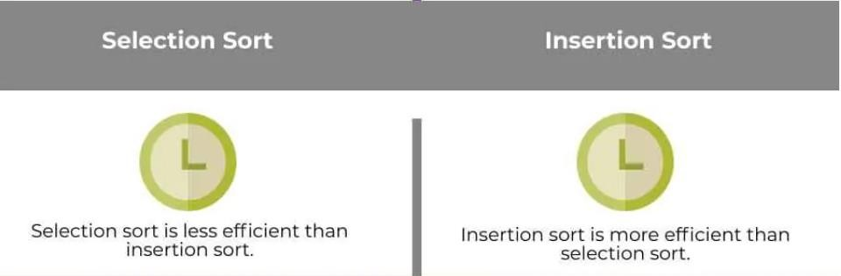
Comparison of Selection and Insertion Sort

Slide 18
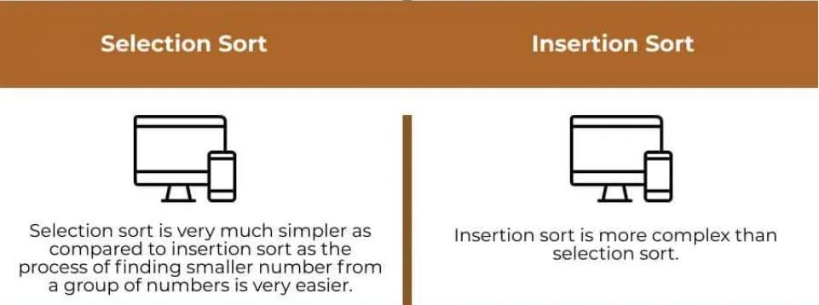
Comparison of Selection and Insertion Sort

Slide 19
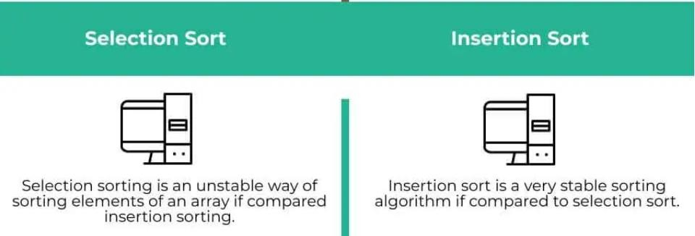
Comparison of Selection and Insertion Sort

Slide 20
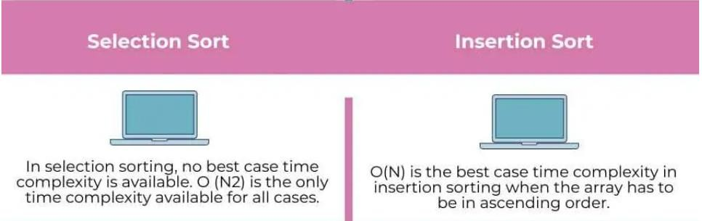
Comparison of Selection and Insertion Sort

Slide 21
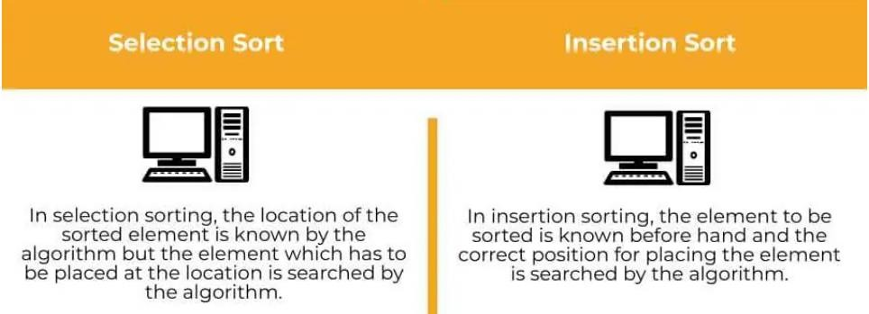
Comparison of Selection and Insertion Sort

Slide 22
Test Your Knowledge
Q1 Consider a situation where swap operation is very costly. Which of the following sorting algorithms should be preferred so that the number of swap operations are minimized in general?
Heap Sort
Selection Sort
Insertion Sort
Merge Sort Answer (B)
Q2 How many comparisons are needed to sort an array of length 5 if a straight selection sort is used and array is already in the opposite order?
1
5
10
20
Answer (C)

Slide 23
Test Your Knowledge
Q3 In the following scenarios, when will you use selection sort?
The input is already sorted
A large file has to be sorted
Large values need to be sorted with small keys
Small values need to be sorted with large keys Answer (C)
Q4 What is the worst case complexity of selection sort?
O(nlogn)
O(logn)
O(n)
O(n²)
Answer (D)

Slide 24

Test Your Knowledge
Is it the right code for the selection sort?
def selection_sort(arr):
n = len(arr)
for j in range(n - 1):
min_index = j
for k in range(j + 1, n - 1):
if arr[k] < arr[min_index]:
min_index = k
# Swap the elements
temp = arr[min_index]
arr[min_index] = arr[j]
arr[j] = temp
# Example usage:
arr = [29, 10, 14, 37, 14]
selection_sort(arr)
print("Sorted array:", arr)

Slide 25
Test Your Knowledge
Q2 The given array is arr = {3,4,5,2,1}. The number of iterations in bubble sort and selection sort respectively are
Q3 Consider the situation in which assignment operation is very costly. Which of the following sorting algorithm should be performed so that the number of assignment operations is minimized in general?

Slide 26
References
https://www.hackerearth.com/practice/algorithms/sorting/selection-sort/tutorial/
https://www.freecodecamp.org/news/most-asked-questions-about-selection-sort/
https://www.scholarhat.com/tutorial/datastructures/selection-sort-in-data-
structures
https://www.scaler.com/topics/data-structures/selection-sort/
https://visualgo.net/en/sorting
https://www.youtube.com/watch?v=EwjnF7rFLns
Dr. Swati, Ms Suman & Ms Neetu

Slide 27
REVIEW
In Selection Sort each of its iterations, it finds the smallest/largest element in the unsorted sub array and moves it to the sorted sub array.
It operates by maintaining a partition of the given array into the
following two arrays, at any point:
The subarray which is already sorted.
The remaining subarray, which has yet not been sorted.

Slide 28

THANK YOU

